Slide 1

CST499 Final software project
Kellen Razzano

Slide 2

Week 5 – Final Project Kellen Razzano CST499 Capstone for Computer Software Technology Professor Joseph Rangitsch 8/26/24
Final Software Project

Slide 3


Software requirements specification
Create a software product to allow students to enroll online and manage their educational courses at a school or university.
User Login
New User Registration
Course Catalog
Add/Remove Classes
View Classes
Logout

Slide 4
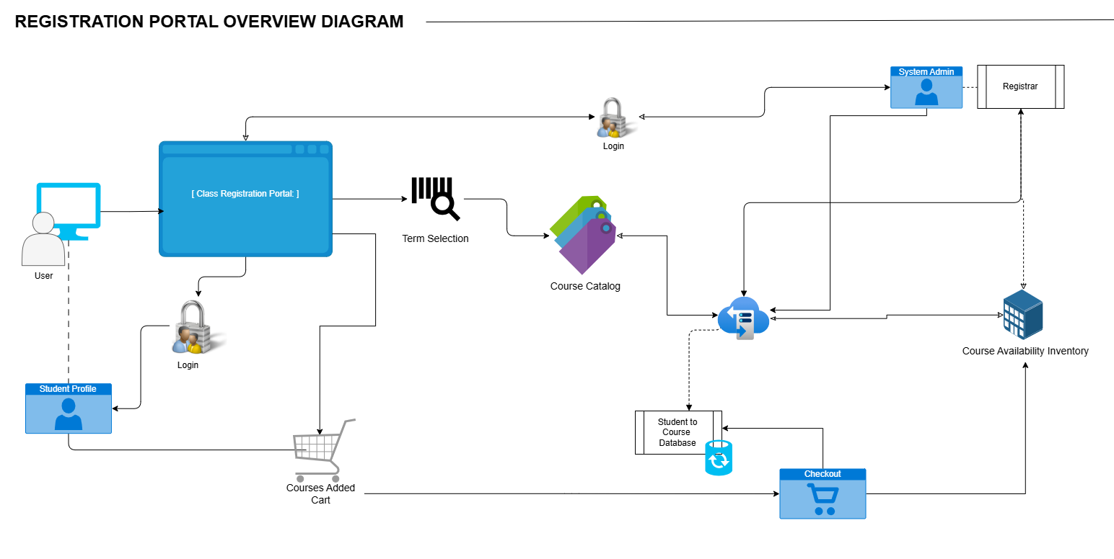
System flow model

Slide 5
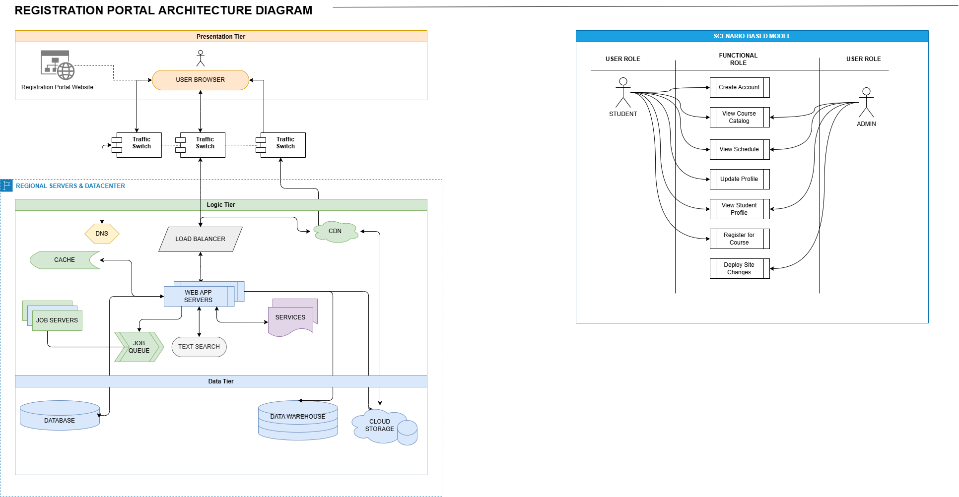
Architecture model

Slide 6
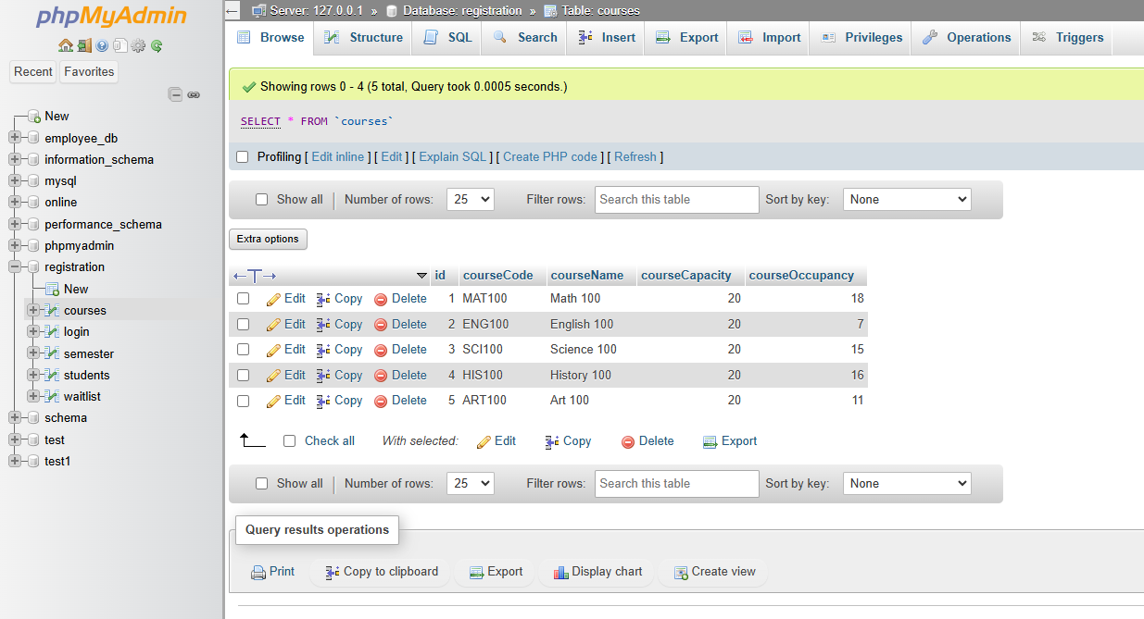
Sql database & tables

Slide 7
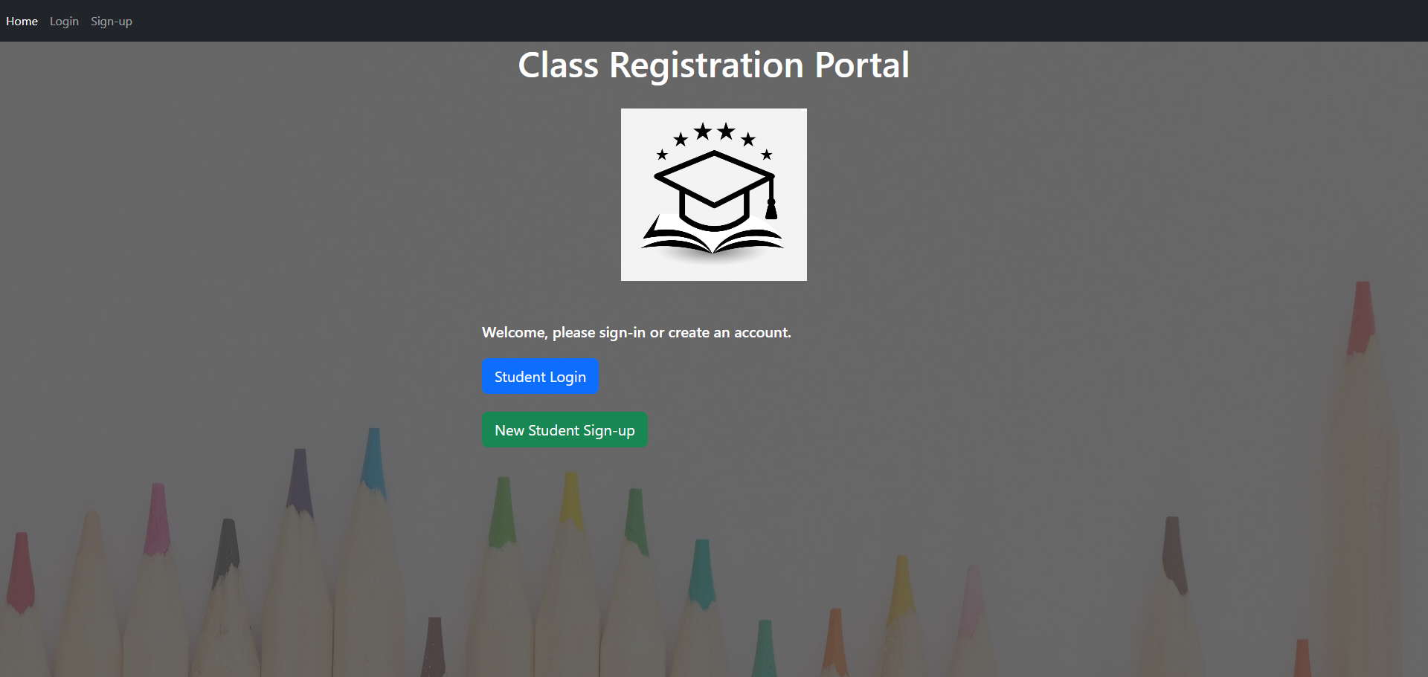
Landing page

Slide 8
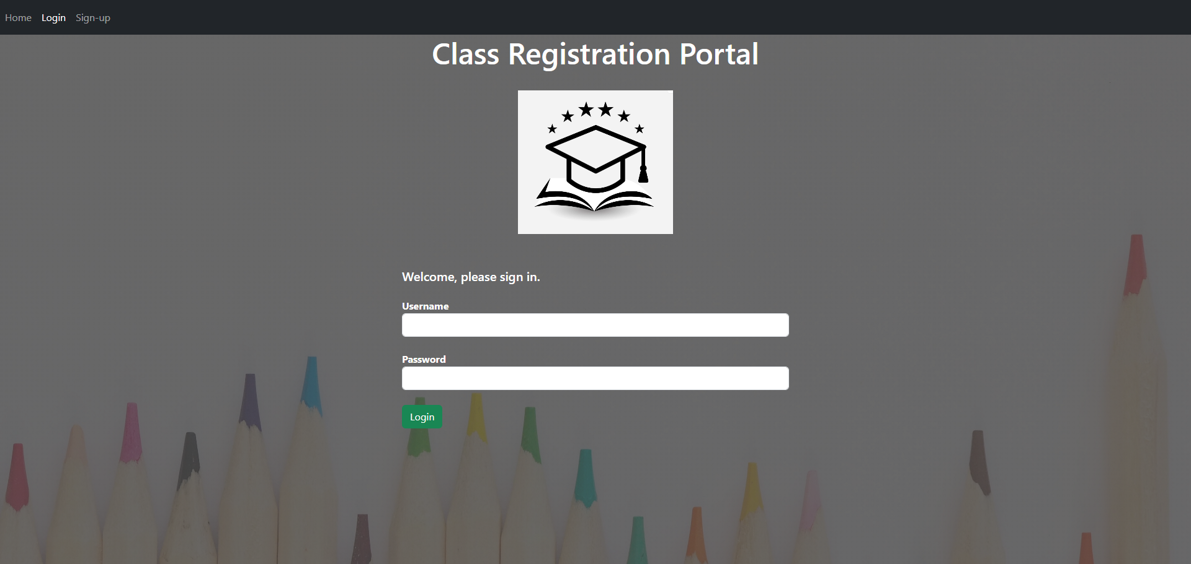
Login page

Slide 9
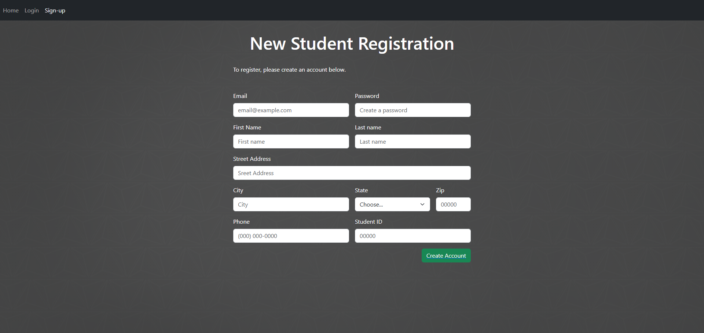
Enrollment page

Slide 10
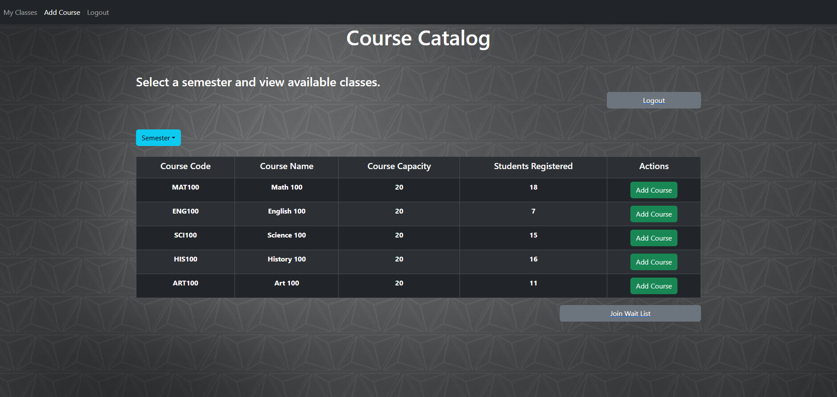
Class registration page

Slide 11
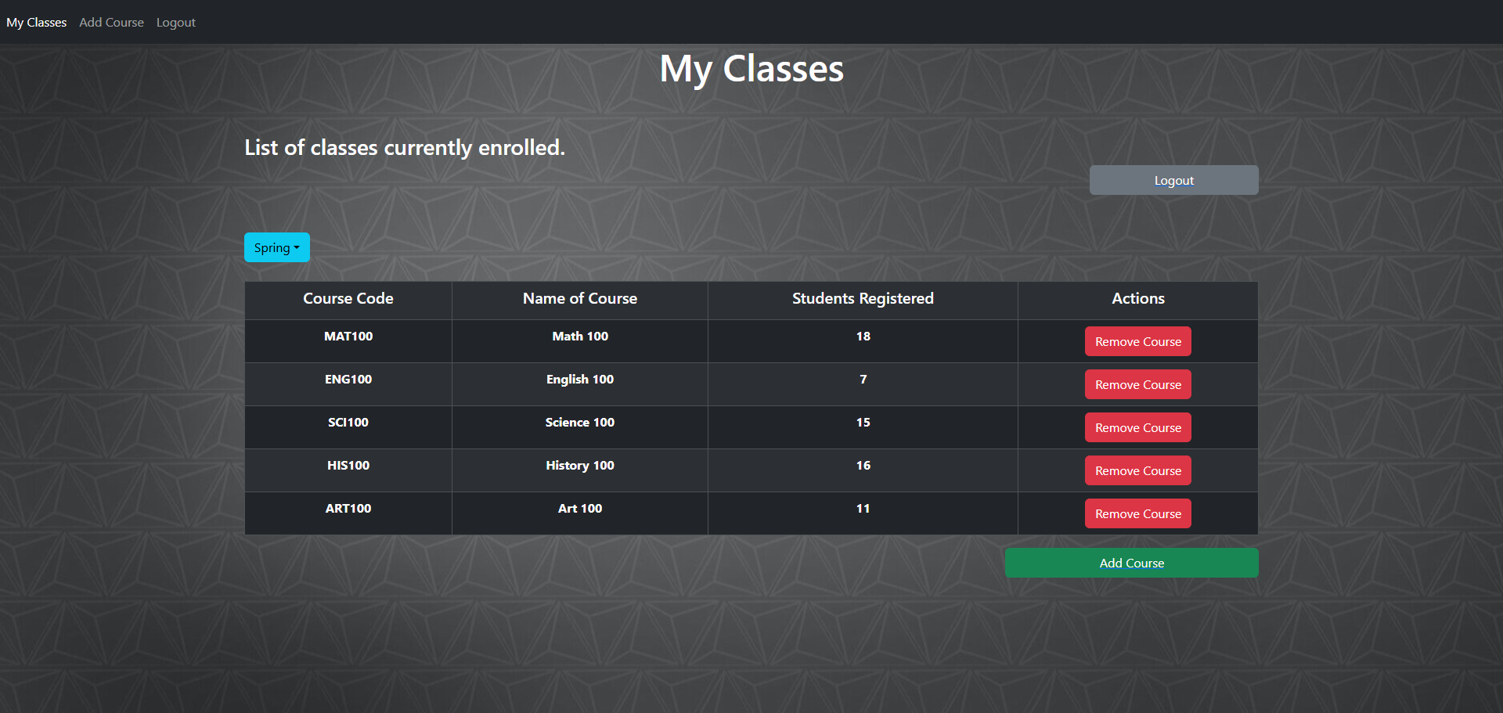
My classes page

Slide 12
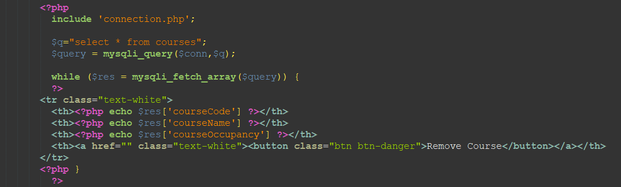
My classes SQl

Slide 13
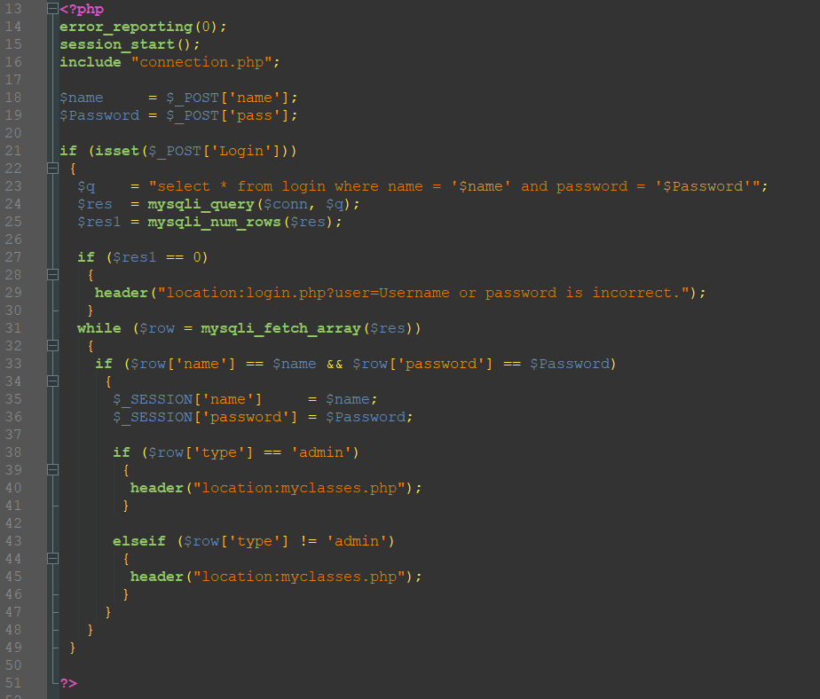
Login SQl

Slide 14
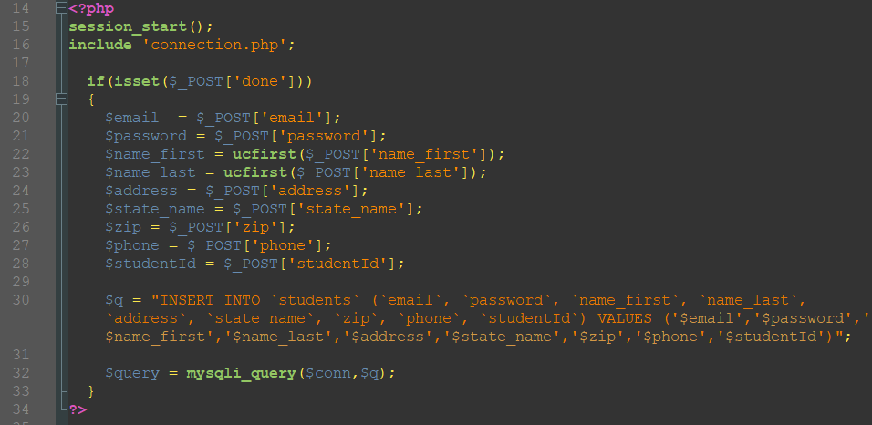
enrollment SQl

Slide 15
Week 5 – Final Project Kellen Razzano CST499 Capstone for Computer Software Technology Professor Joseph Rangitsch 8/26/24
Final Software Project

